Slide 1
UNDERSTANDING COOPERATIVE BEHAVIOR IN ONLINE GAMES: A PARTIAL ENTROPY APPROACH
Candidato: Cota Andrea Pio Maria (866282)
Relatore: Giovanni Petri
Correlatore: Michele Starnini
Controrelatore: Piero Fariselli

Slide 2

Introduction
Aim: Understanding community dynamics of users
Where: Online social context ("r\Place")
What: Identify collaboration patterns
How: Multiple analysis types, focusing on Partial Entropy Decomposition (PED)

Slide 3
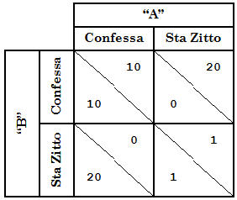
Social systems and cooperation
A social system essentially consists of two or more individuals who interact directly or indirectly under limited circumstances.
Key point: individuals can collaborate (i.e., align toward a common goal)
An example: Prisoner's Dilemma
Emergence of collective solution that benefit the entire group

Slide 4

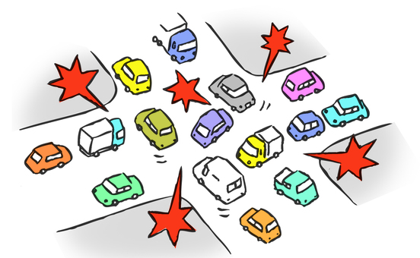
Emergence in online social contexts
Emergent phenomena result from the interactions of individual entities (example: traffic jam).
The emergence of cooperation is a fundamental feature of complex systems and, with the raise of social media and social networks, this phenomenon manifested also in online contexts.
Cooperation
Social media
Reddit
r\Place 2017
Social networks
Big Data
Analysis
Insights
So, what's Reddit Place?

Slide 5
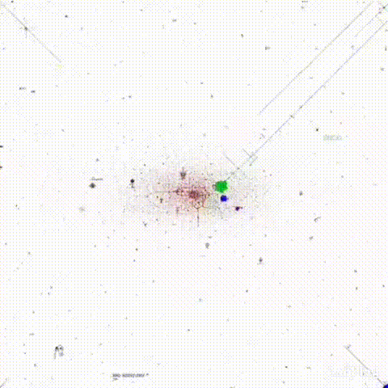
No further instructions given.
Final outcome of the experiment: unpredictable/emergent

Slide 6
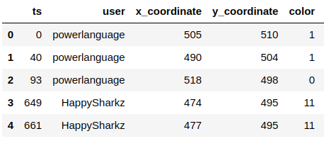
The Dataset
Final canvas resulted in approx 1500 artworks (sports, video games, comics and more);
Artwork ---> subreddit;
Dataset composed of over 16 million rows;

Slide 7
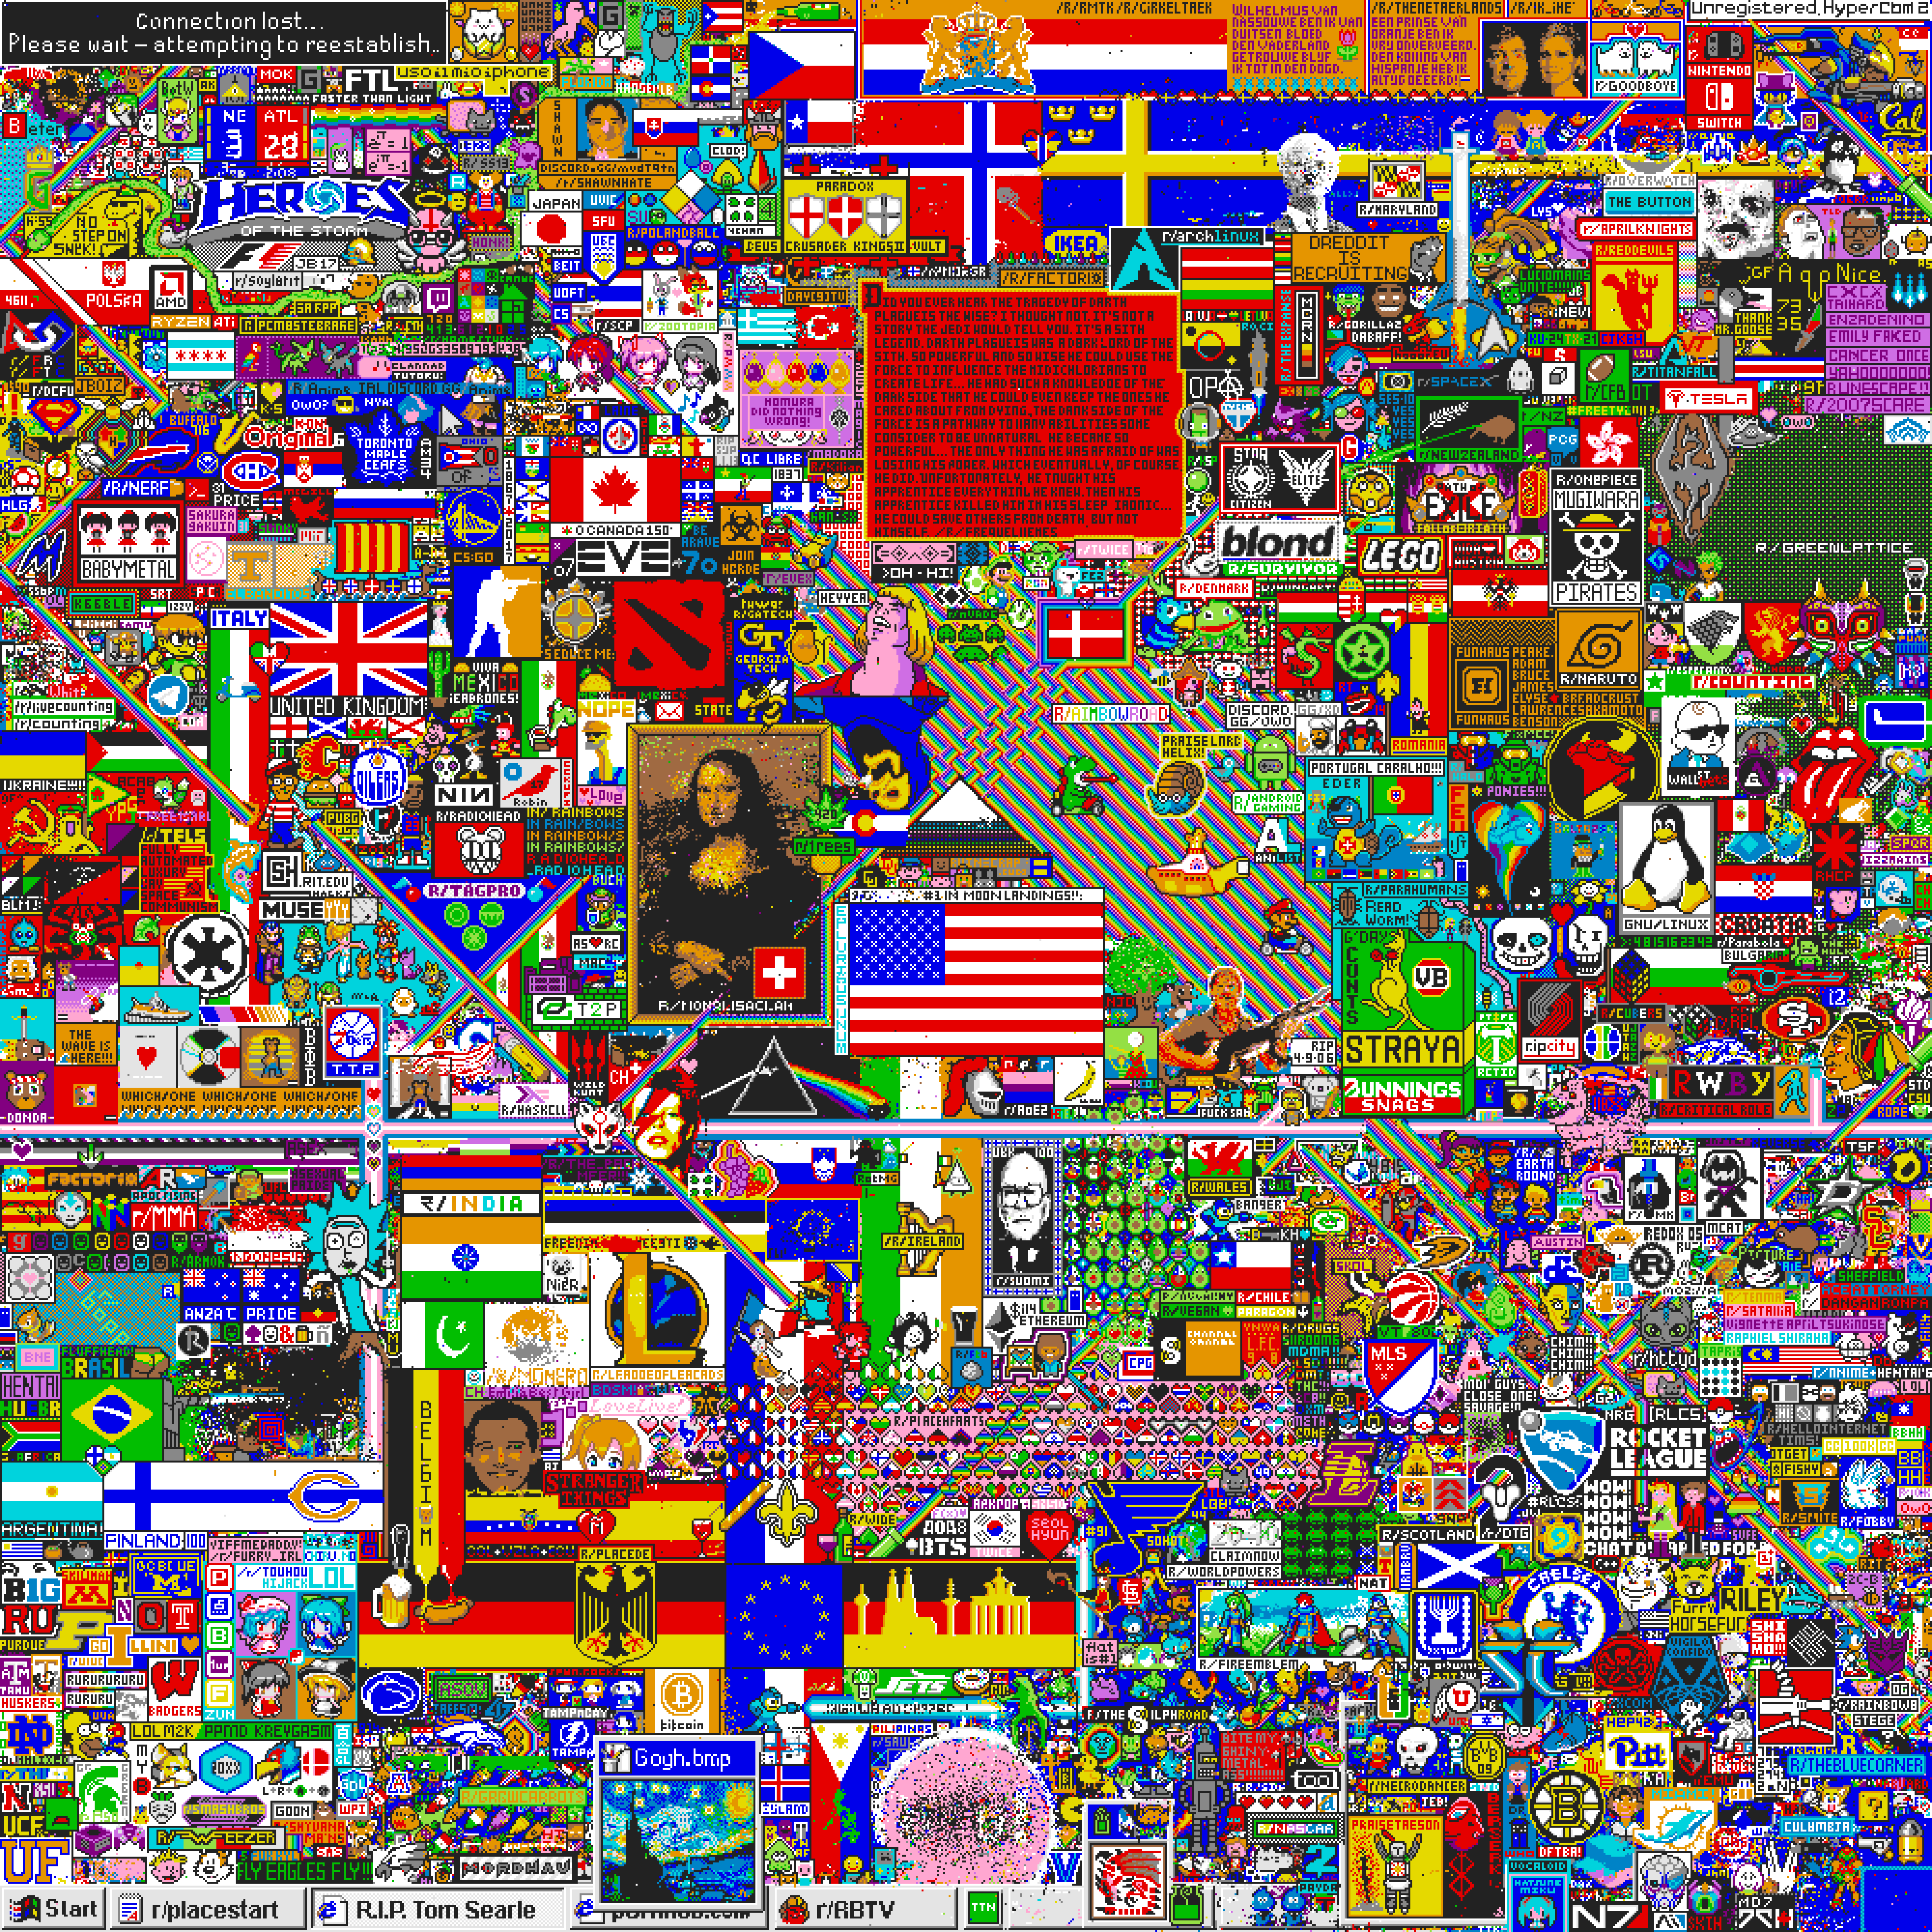
1
1
IDENTIFYING AND SELECTING ARTWORKS
2
DISCOVERING RELATIONSHIPS BY DEFININING INTERACTIONS
3
GENERATING SYNTHETIC TIMESERIES USING GILLESPIE ALGORITHM
4
PERFORMING PARTIAL ENTROPY DECOMPOSITION

Slide 8
1
1
IDENTIFYING AND SELECTING ARTWORKS
2
DISCOVERING RELATIONSHIPS BY DEFININING INTERACTIONS
3
GENERATING SYNTHETIC TIMESERIES USING GILLESPIE ALGORITHM
4
PERFORMING PARTIAL ENTROPY DECOMPOSITION

Slide 9
1
1
IDENTIFYING AND SELECTING ARTWORKS
2
DISCOVERING RELATIONSHIPS BY DEFININING INTERACTIONS
3
GENERATING SYNTHETIC TIMESERIES USING GILLESPIE ALGORITHM
4
PERFORMING PARTIAL ENTROPY DECOMPOSITION

Slide 10
1
1
IDENTIFYING AND SELECTING ARTWORKS
2
DISCOVERING RELATIONSHIPS BY DEFININING INTERACTIONS
3
GENERATING SYNTHETIC TIMESERIES USING GILLESPIE ALGORITHM
4
PERFORMING PARTIAL ENTROPY DECOMPOSITION

Slide 11
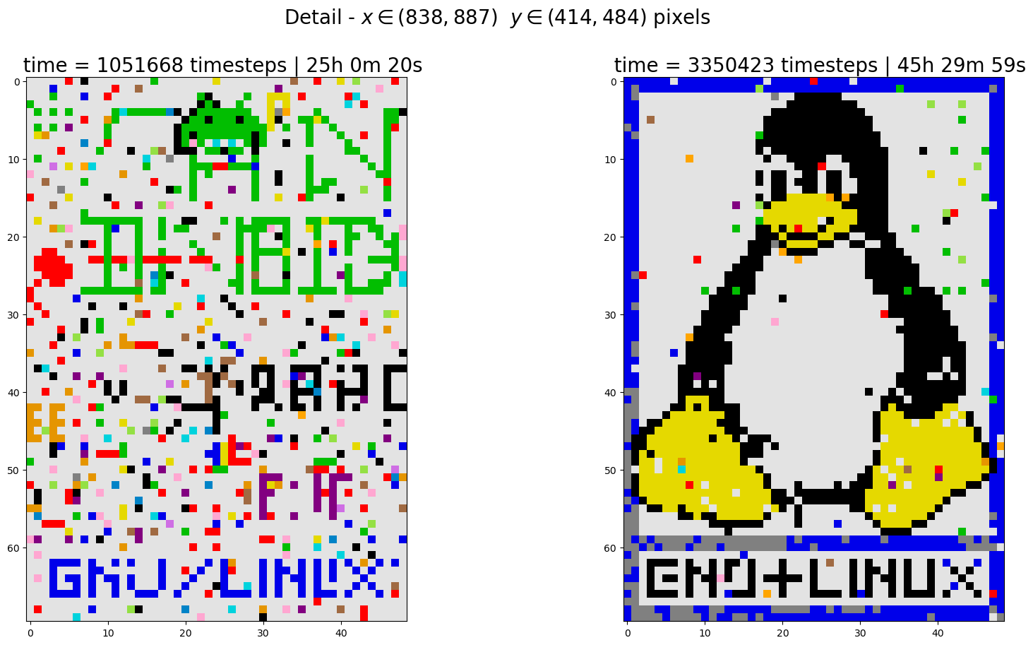
Methods 1 - Identifying artworks
!
Bias
Only regular shaped artworks

Slide 12
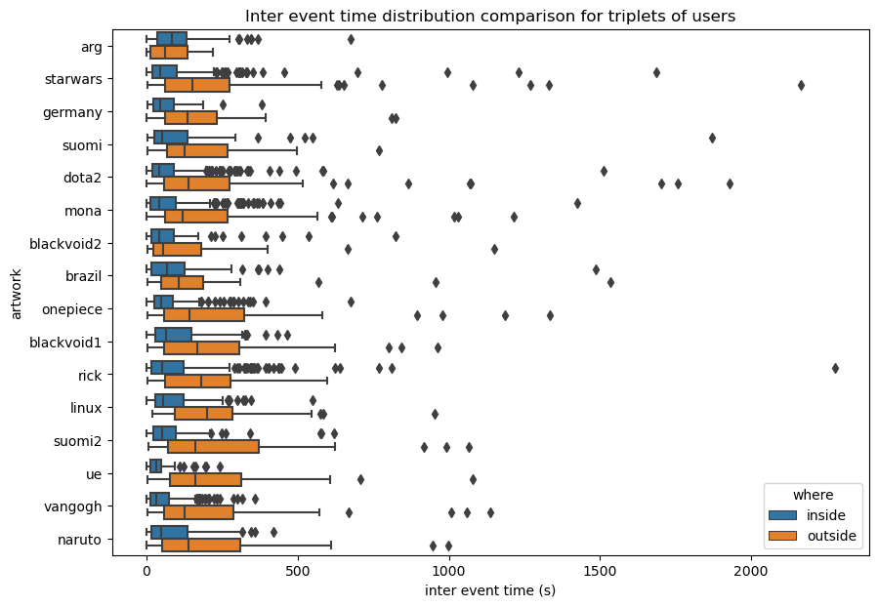
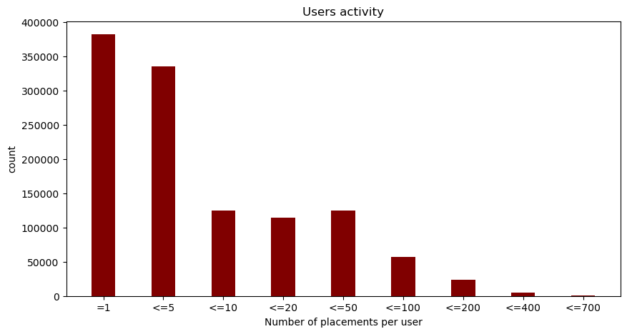
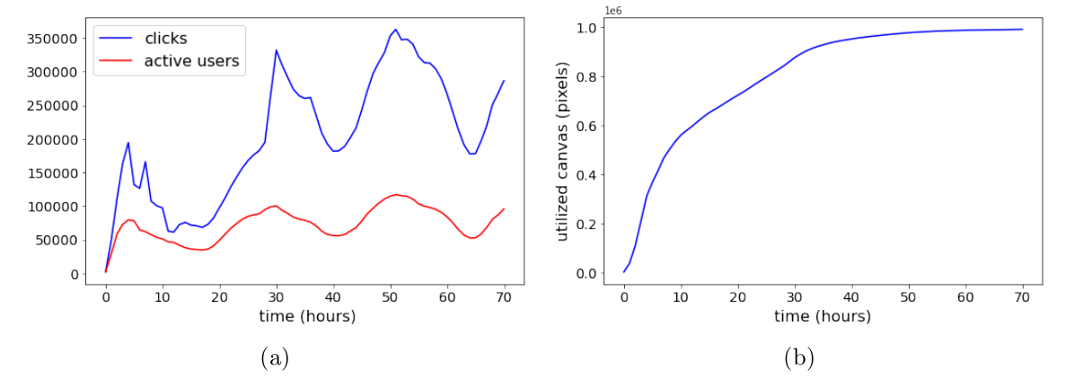
Results – Preliminary analysis (activity and inter-times)

Slide 13
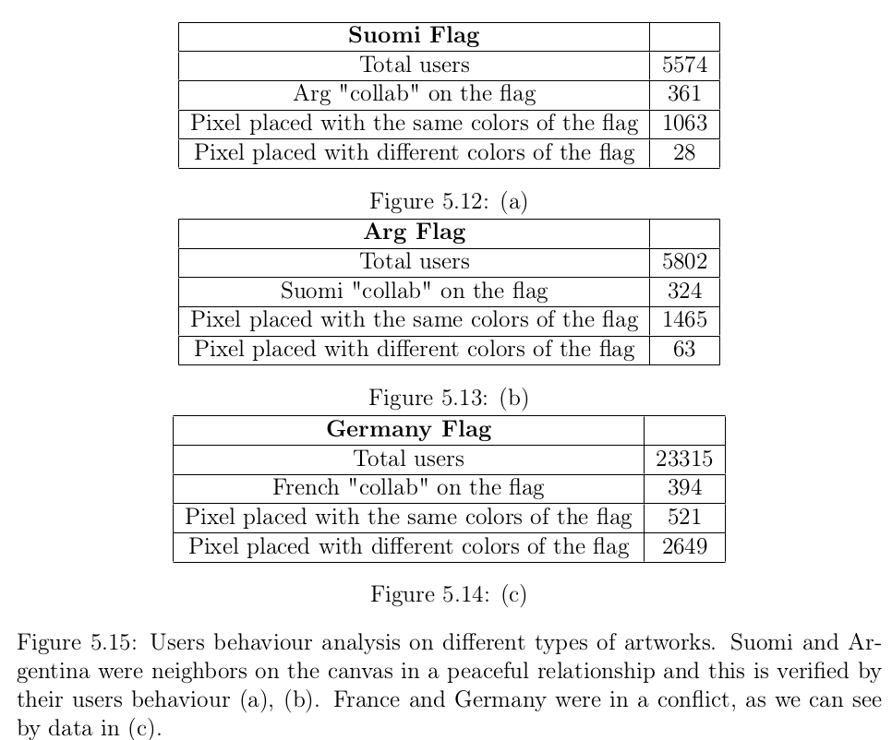

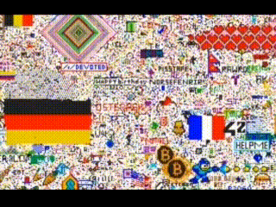
Results – Exploratory analysis (cooperation and conflicts)
Cooperation
Conflict
"collab": the users who only placed pixel with the main colors of their flag

Slide 14
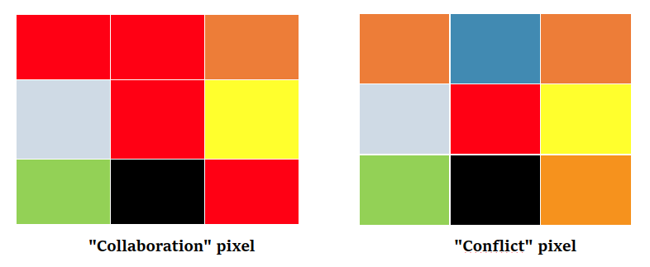
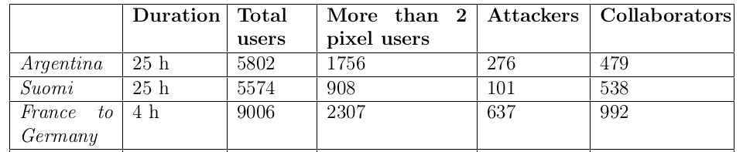
We improved our analysis using a more powerful tool:
We removed from our analysis the users with < 3 placements;
We label the users using a majority rule:
If the color of the central cell is equal to the mode of the neighbors colours then that pixel is a "collab" pixel, otherwise is a "conflict" pixel;
Then we label users as:
Attackers: 0 "collab" pixel;
Collaborators: 0 "conflict" pixel.

Slide 15
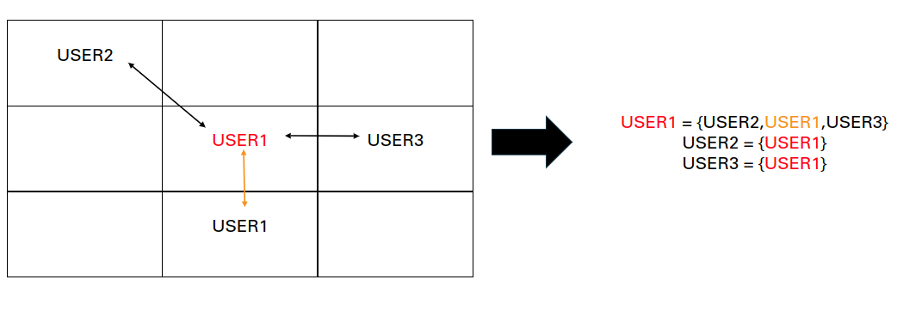
Methods 2 – Defining Interactions
"An interaction will occur if, in the last 10 minutes since the timestamp of a placed pixel by a user, other users or the same user are/is in one of the 8 surrounding positions of the central one."
N.B. More timedeltas have been tested

Slide 16
Methods 2 – Defining Interactions
 | User1 | User2 | User3 | User4 | User5
User1 | 0 | 3 | 2 | 0 | 4
User2 | 3 | 2 | 1 | 5 | 3
User3 | 2 | 1 | 6 | 2 | 7
User4 | 0 | 5 | 2 | 4 | 0
User5 | 4 | 3 | 7 | 0 | 1
ALSO RANDOM EFFECT IS PRESENT
NULL MODEL
INITIAL INT. - NULL INT. = "REAL" INT.
SELF-INTERACTIONS

Slide 17
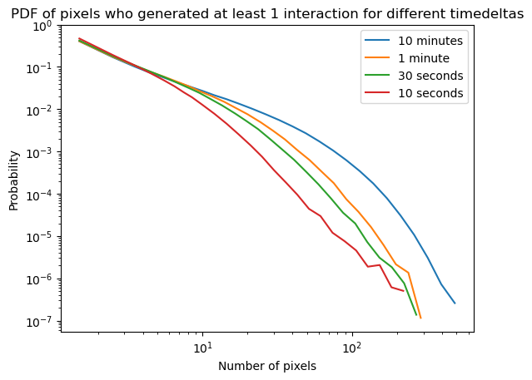
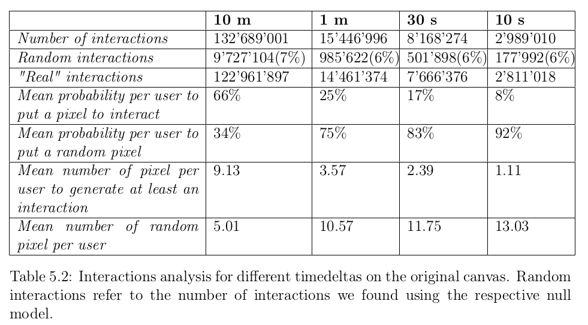
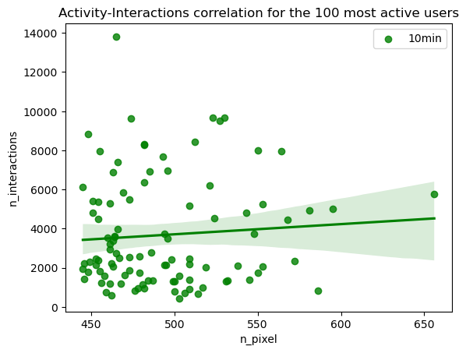
Results – Interactions analysis
T
I
ME
D
E
L
T
A
R
A
N
D
O
M

Slide 18
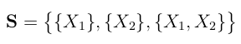
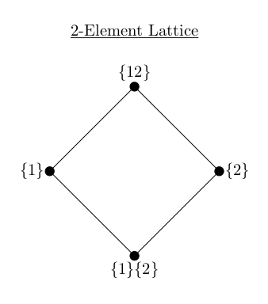
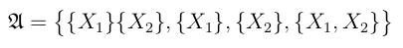
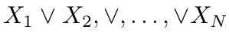
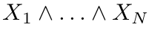
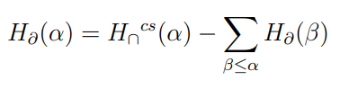
Methods 3 - PED
The size of the power set grows hyper-exponentially with the number of elements being considered.
2 predictors --> four distinct atoms
3 predictors --> 18 atoms
4 predictors --> 166 atoms
8 predictors --> ≈ 5.6 × 10 ²² atoms
PED applicability to large systems is limited.
To study statistical dependencies between three or more variables (“Higher order” interactions) one of the tool most well developed is the partial information decomposition (PID).
For this thesis work we used one of his generalization: Partial Entropy Decomposition (PED)
Es. N = 2
Redundancy
Define the set of sources:
Define the power set of S ("atoms"):
N.B. no source is a subset of any other.
The set has an ordered structure:
3. Perform "Mobius-inversion":
Synergysm
information that is “duplicated” over many elements
information that is only accessible when considering the joint-states of multiple elements
partial entropy function
entropy
redundancy value

Slide 19
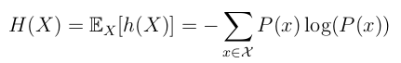
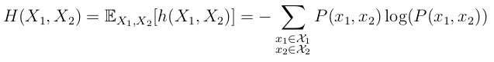
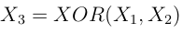
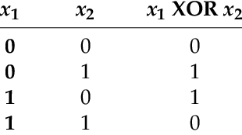
Methods 4 – Partial Entropy decomposition
Let's consider the case where X₁ and X₂ both “listen to” X₃ , but have no coupling between each-other (no information passes from X₁ to X₂ , but they both receive information from X₃).
Shannon entropy
Joint entropy
= 0
Here, redundant information has been conditioned out.
This implies that the same information could be acquired by observing X₁ V X₂ V ... V X_{N}
Mutual Information
Synergysm referrers to information that is only present in the joint-states of two or more elements of the system and cannot be extracted from single variables considered alone.
Due to the synergistic nature of the XOR function, the relationship between all three variables only comes into view when information from all three are accounted for.
This occurs because the output of the XOR function cannot be known from a single argument: knowledge about both X₁ and X₂ are necessary to determine whether X₃ will be 0 or 1 bit.

Slide 20
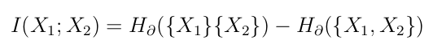
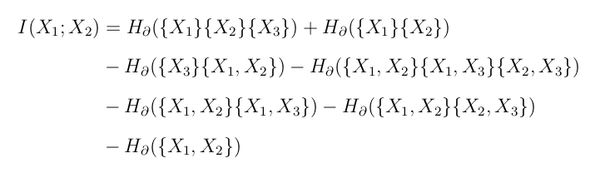
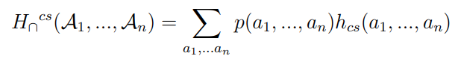
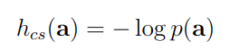
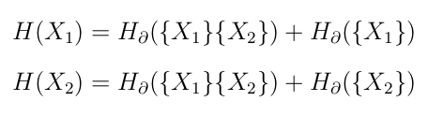
Methods 4 – Partial Entropy decomposition
N = 2
The most straightforward generalization of the PID is the partial entropy decomposition (PED).
Instead of mutual information, the PED decomposes the joint entropy of a set of variables without requiring categorizing some as sources and others as targets.
After the choice of a redundant entropy function ("Common Surprisal)":
it is possible to define a redundancy lattice that can be solved via Mobius inversion in the same way:
N = 3
where
bivariate mutual information may not be “specific”: a dependency between
two variables does not necessarily contain only information shared by only those 2!

Slide 21
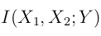
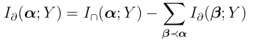
The size of the power set grows hyper-exponentially with the number of elements being considered.
2 predictors --> four distinct atoms
3 predictors --> 18 atoms
4 predictors --> 166 atoms
8 predictors --> ≈ 5.6 × 10 ²² atoms
PID applicability to large systems is limited.
We have previously made reference to the idea that information can be synergistically or redundantly shared between multiple sets of elements of a complex system.
Of the tools that have been applied to infer high-order interactions, one of the most well developed is the partial information decomposition (PID), which reveals that multiple interacting variables can participate in a variety of distinct information-sharing relationships, including redundant, unique, and synergistic modes.
Suppose we have a system of N predictor variables, all informing about the state of a single target Y. We would like decompose the joint mutual information I(X₁ , . . . , X_{N} ; Y) down into all relevant combinations of sources.
Es. N = 2
Define the set of sources:
Define the power set of S ("atoms"):
N.B. no source is a subset of any other.
The set has an ordered structure:
3. Perform "Mobius-inversion":
partial information function
information
redundancy value of that node

Slide 22
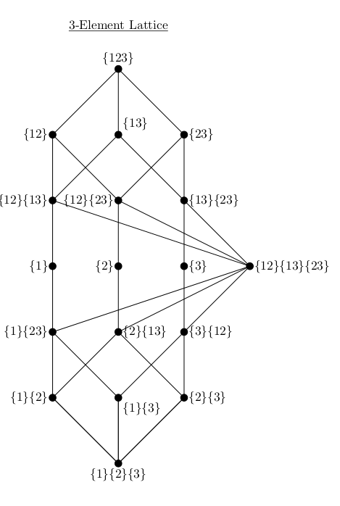
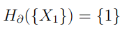
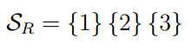
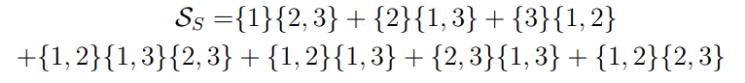
Our PED configurations
Es.
Redundant and synergistic information proposed by Varley et al¹:
We selected triplets of users with comparable activities.
Our configurations:
Spatial cuts & number of times they did anything in intervals of 30 m
Equal or different colors & number of times they did anything in intervals of 30 m
Majority rule & number of times they did anything in intervals of 120 m
Majority rule & number of times they did anything in intervals of 60 m
¹T. F. Varley, M. Pope, and O. Sporns, “Partial entropy decomposition reveals higher-order information structures in human brain activity”

Slide 23
Results – PED analysis
Technique: we examined variations in information measures within the context of inside/outside artworks;
Subset: we selected 16 distinct artworks, and for each one we selected a unique user triplet;
How: we tested 4 different configurations of the PED;
Redundancy is what we expect to be higher inside the artworks, because it represents the users working on the same symbol (that is a specific action) and we know that in some way users collaborated inside these zones;
Unexpected synergysm output: it stands for the fact that users, in parallel, work on different commitments, maybe different areas or colors;

Slide 24
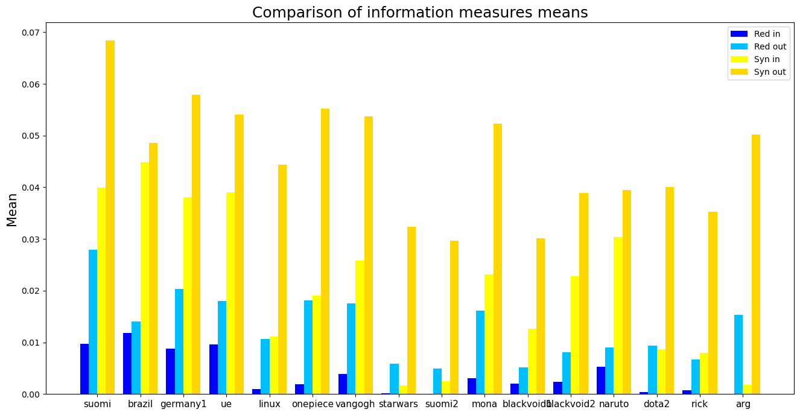
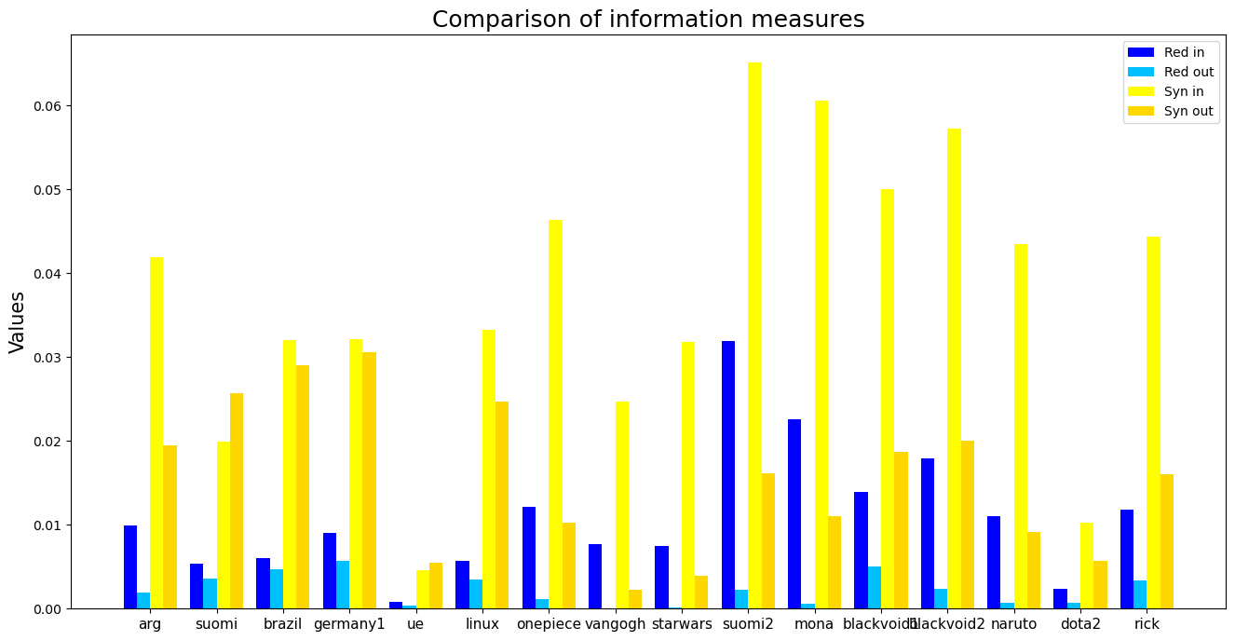
Results – PED analysis
1: [up, right, up-diagonal cut1, up-diagonal cut2], ​
2: [down, left, down-diagonal cut1, down-diagonal cut2]
3: [the number of times every user did nothing for 30 minutes]
1: [number of times evey user placed pixel with the same color]
2: [number of times evey user placed pixel with the different color]
3: [the number of times every user did nothing for 60 minutes]
what happens if we involve color feature?

Slide 25
Results – PED analysis
1: [up, right, up-diagonal cut1, up-diagonal cut2], ​
2: [down, left, down-diagonal cut1, down-diagonal cut2]
3: [the number of times every user did nothing for 30 minutes]
1: [number of times evey user placed pixel with the same color]
2: [number of times evey user placed pixel with the different color]
3: [the number of times every user did nothing for 60 minutes]
Using "Equal or different colors & number of times they did anything in intervals
of 60 minutes"
Using "Spatial cuts & number of times they did anything in intervals of 30 minutes"

Slide 26
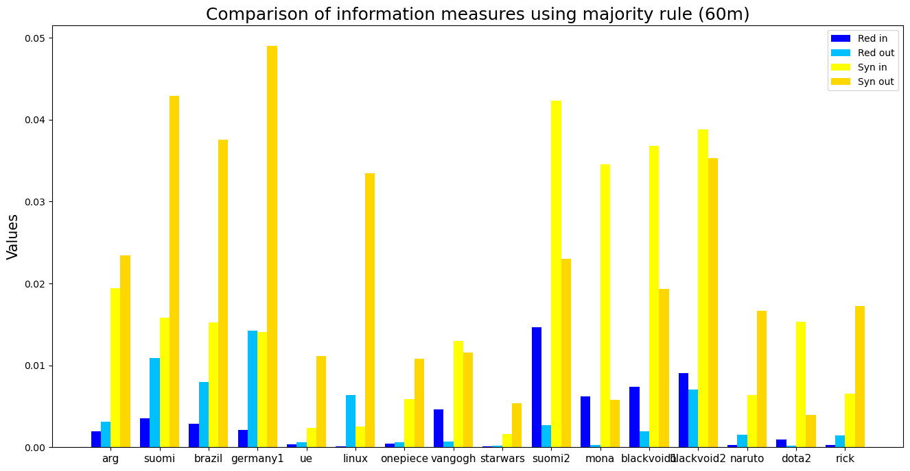
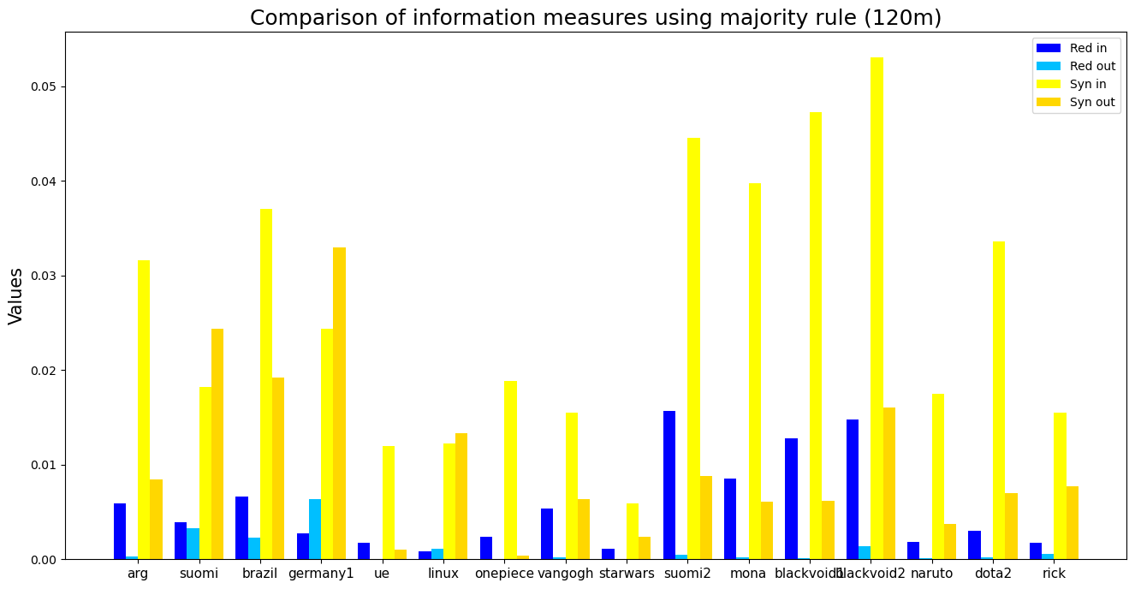
Results – PED analysis
1: number of 'collab' pixels using majority rule;​
2: number of 'conflict' pixel using majority rule;​
3: number of times users did anything every 2 hours;
1: number of 'collab' pixels using majority rule;​
2: number of 'conflict' pixel using majority rule;​
3: number of times users did anything every hour;
Using "Majority rule & number of times they did anything in intervals
of 60 minutes"
Using "Majority rule & number of times they did anything in intervals
of 120 minutes"
We believe we found the most suitable symbols configurations for our case-study

Slide 27
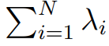
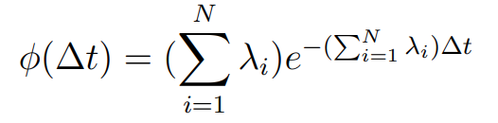
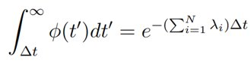
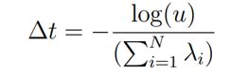
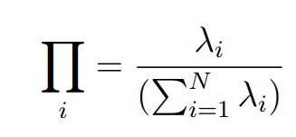
N independent Poisson processes with a rate of λi (1 ≤ i ≤ N) running in parallel.
Their combination results in a new Poisson process with a rate equal to the sum of the individual rates, which is:
The algorithm begins by drawing a time increment, ∆t, to the next event of this combined Poisson process from an exponential distribution defined as:
To find ∆t, we use the survival function (i.e., the probability that a random variable exceeds a certain value) of phi, given by:
which allows us to calculate ∆t as:
The algorithm identifies which process, denoted as i, has generated the event with a probability given by:
Finally, the algorithm advances time by ∆t and repeats the procedure.

Slide 28
Results – PED analysis
1: number of 'collab' pixels using majority rule;​
2: number of 'conflict' pixel using majority rule;​
3: number of times users did anything every 2 hours;
1: number of 'collab' pixels using majority rule;​
2: number of 'conflict' pixel using majority rule;​
3: number of times users did anything every hour;
Using "Majority rule & number of times they did anything in intervals
of 120 minutes"
Using "Majority rule & number of times they did anything in intervals
of 60 minutes"

Slide 29
Methods 4 – Generating synthetic timeseries
Our GilleSpie algorithm
Choose a random user based on his rate per hour
Assign randomly one timestamp value to the user
Random Position
Choose a random color
Near any user who placed in the last n-minutes
Self interaction
"Other" interaction
Choose a random color
Choose a random color
For our case-study, the N Poissonian processes are the users placements. Here, the rate λi is the activity rate per hour of every user.
The timestamps of the placements of the users will be randomly extracted from a poissonian distribution with mean the sum of the rates of the users we selected.
*
*
N.B. "n" and "L" parameters;
*Based on probabilities

Slide 30
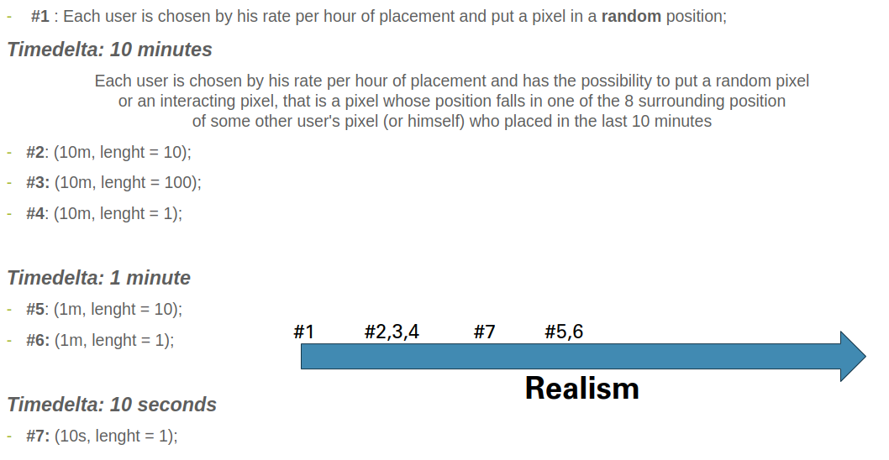
Results – Timeseries analysis
To generate comparison timeseries we implemented the following models:
Then we compared models entropy values with those outside the real canvas.

Slide 31
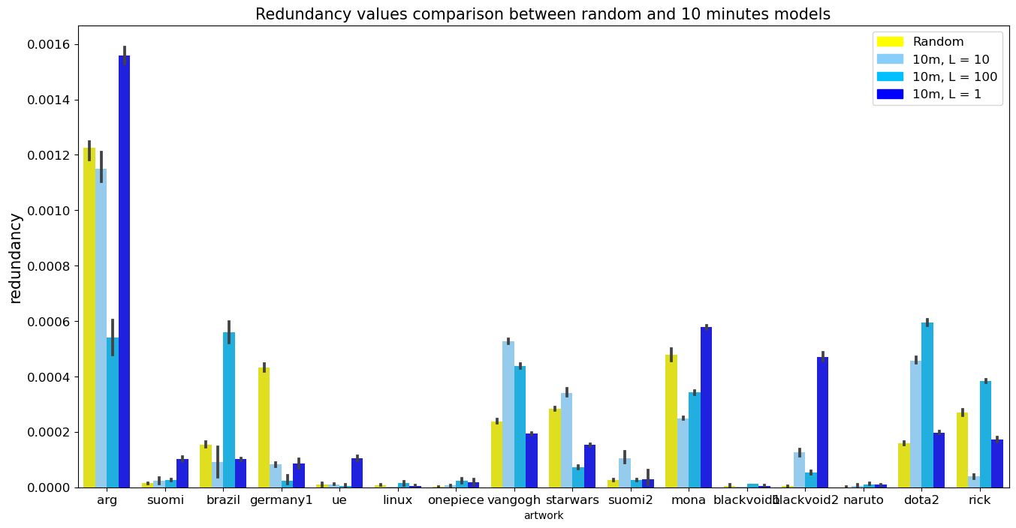
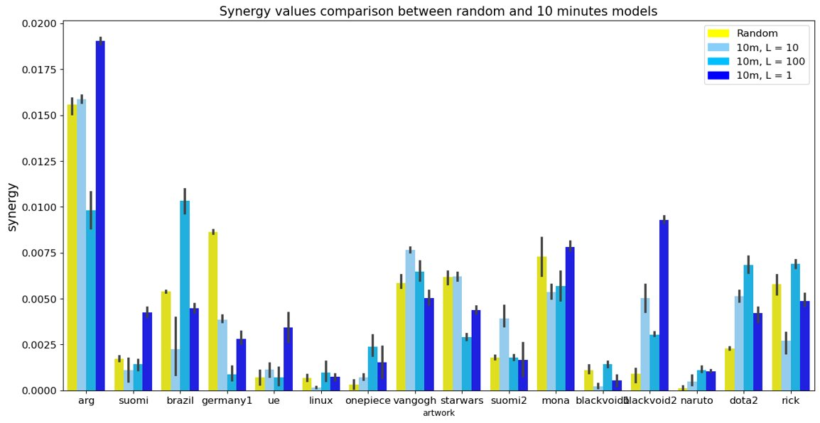
Random VS 10 minutes timedelta

Slide 32


1m VS 10s

Slide 33


Real VS 10s

Slide 34
Conclusions:
✓we revealed specific trends of activity distribution across the canvas;
✓we were able to discriminate users behaviour inside/outside artworks;
✓we found out that majority rule was the strongest measure to capture the dynamics involved between users belonging to 2 or more communities and it seemed to be the most appropriate tool to be incorporated within the PED to identify collaboration between users;
✓we discovered users tendency variations to interact or not based on the timedelta used for the type of interaction under consideration;
✘ We were not able to replicate canvas dynamics using our first definition of interaction and Poissonian GilleSpie algorithm.
Future works:
Improve existing and create new definitions of interactions testing their goodness;
Most of the work can be done in trying to replicate the canvas dynamics, for example with the use of a non-poissonian gillespie algorithm;
One could attempt to map user behavior in specific areas by selecting more than three users at time, even if this can lead to much greater analytical and computational efforts.

Slide 35
Grazie dell'attenzione

